Slide 1
Unit 2
Topic 2
Phrases and Clauses

Slide 2
How to tell the difference…
Independent
(main)
Clause
Subordinate
(dependent)
Clause
Phrase
Has a subject and verb
YES
YES
NO
Forms a complete thought
YES
NO
NO
Can stand alone
YES
NO
NO

Slide 3
Independent Clause
DEFINITION: An independent (or main)
clause expresses a
complete thought.
It can stand by itself as a sentence.
It has both a subject and a verb.

Slide 4
Independent Clauses
Halle ate a late dinner.
Kevin went to the movies.
Travis and Eric gave donations to help others.
Savannah collected money.
Caleb wandered off.
Mercy offered us a ticket.

Slide 5

Subordinate Clause
DEFINITION: A subordinate (or dependent) clause does NOT
express a complete thought.
It does have a subject
and a verb.
BUT… it cannot stand
alone as a sentence.

Slide 6
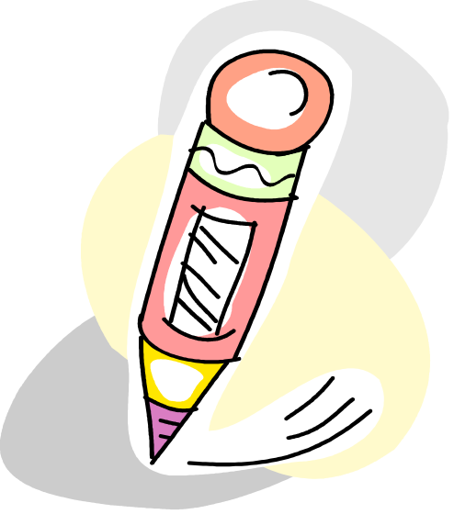
Subordinate Clause
A word such as that, what or since signals the beginning of a subordinate clause.
  that I wanted
  what she saw
  since most plants die without water
The meaning of a subordinate
clause is only complete after the
clause is attached to an independent clause.

Slide 7

Subordinate Clauses
after Kedon ate dinner
because Mary saved the drowning girl
when Amy gave a party
that we thought was right
before Sam left the room
whom Mrs. Brooks knew

Slide 8

Phrases
DEFINITION:
DO NOT have subjects OR verbs.
DO NOT form complete thoughts.
CANNOT stand alone.

Slide 9
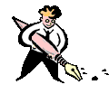
Phrases
after the party
because of the rain
in the car at the mall
starting with the rules
between classes
near the park entrance

Slide 10

Subordinate Conjunctions
Subordinate conjunctions form subordinate clauses.
Subordinating conjunctions are ADVERBS used as conjunctions to join subordinate and independent clauses.
Subordinate conjunctions can be found at the beginning, middle or end of a sentence.

Slide 11

Subordinate Conjunctions
Subordinate conjunctions answer:
  Who?
  What?
  When?
  Where?
  Why?
  Under what condition?

Slide 12
Subordinate Conjunctions
after | if, even if | when, whenever
although, though | in order that | where, wherever
as | since | whether
because | that, so that | which, whichever
before | unless | while
even though | until | who
how | what, whatever | whose

Slide 13
Subordinate Clauses
when she left the movies
  SHE is the SUBJECT.
  LEFT is the VERB.
  WHEN is the subordinating conjunction.

Slide 14
Subordinate Clauses
although we ate dinner
  WE is the SUBJECT.
  ATE is the VERB.
  ALTHOUGH is the subordinating conjunction.

Slide 15
Subordinate Clauses
because they did a good job
  THEY is the SUBJECT.
  DID is the VERB.
  BECAUSE is the subordinating conjunction.

Slide 16
Subordinate Clause PRACTICE
Underline the SUBJECT once.
Underline the VERB twice.
Draw a circle around the subordinating conjunction.

Slide 17
Subordinate Clause PRACTICE
We hated the pizza because it tasted like cardboard.
After we threatened to hurt them, they gave us the answers to the test.
Emily can not do her homework until she watches her favorite television show.
Since the car does not run well, the mechanic did a quick check-up.

Slide 18
Subordinate Clause PRACTICE
We hated the pizza because it tasted like cardboard.
  We hated the pizza — independent clause
  because it tasted like cardboard — subordinate clause
    because — subordinating conjunction
    tasted — verb
    it — subject

Slide 19
Subordinate Clause PRACTICE
  After we threatened to hurt them, they gave us the answers to the test.
  They gave us the answers to the test — independent clause
  after we threatened to hurt them — subordinate clause
    after — subordinating conjunction
    threatened — verb
    we — subject

Slide 20
Subordinate Clause PRACTICE
Emily cannot do her homework until she watches her favorite television show.
  Emily cannot do her homework — independent clause
  until she watches her favorite television show — subordinate clause
    until — subordinating conjunction
    watches — verb
    she — subject

Slide 21
Subordinate Clause PRACTICE
Since the car does not run well, the mechanic did a quick check-up.
  the mechanic did a quick check-up — independent clause
  Since the car does not run well — subordinate clause
    Since — subordinating conjunction
    does run — verb
    car — subject

Slide 22
Clause and Phrase PRACTICE
Underline the SUBJECT once.
Underline the VERB twice.
Draw a circle around the subordinating conjunction.
Determine whether each sentences is a CLAUSE or a PHRASE.

Slide 23
Clause or Phrase? Identify.
to the park in the city
after the winning run was hit
when we gave the children their gifts
before the early show
from the grocery store to the mall
between the two cities on the map
whenever we feel like having chili
since we cannot go to the ballgame

Slide 24
Clause and Phrase Answers
to the park in the city (phrase)
after the winning run was hit (clause-sub)
when we gave the children their gifts (clause-sub)
before the early show (phrase)
from the grocery store to the mall (phrase)
between the two cities on the map (phrase)
whenever we feel like having chili (clause-sub)
since we can not go to the ballgame (clause-sub)

Slide 25

Clause and Phrase Practice
Identify the underlined section in the following sentences as a CLAUSE or PHRASE.

Slide 26
Clause or Phrase PRACTICE
After the movie, we enjoyed a delicious dinner.
We all enjoyed spaghetti that was quite tasty.
After eating dessert, we all pitched in to pay the check.
We were a little short on money which made us very nervous.
Our friend Michael, who is very wealthy, offered to pay the difference.
Before leaving, we all thanked him.

Slide 27
Clause and Phrase Answers
After the movie, we enjoyed a delicious dinner.
  Phrase
We all enjoyed spaghetti that was quite tasty.
  Clause
After eating dessert, we all pitched in to pay the check.
  Phrase

Slide 28
Clause and Phrase Answers
We were a little short on money which made us very nervous.
  Clause
Our friend Michael, who is very wealthy, offered to pay the difference.
  Clause
Before leaving, we all thanked him.
  Phrase

